Slide 1
MEDICAL TERMINOLOGIES - 6

Slide 2
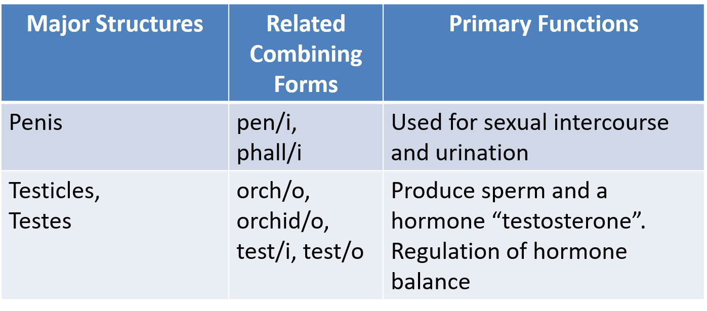
MALE REPR. SYSTEM

Slide 3
Terms Related To The Reproductive Systems of Both Sexes
The Genitalia (jen-ih-TAY-lee-ah) - organs of reproduction and their associated structures.
External genitalia are reproductive organs located outside of the body cavity.
Internal genitalia are reproductive organs protected within the body.
The perineum (pehr-ih-NEE-um) is the external surface region in both males and females between the pubic symphysis and the coccyx.
The male perineum extends from the scrotum to the anus.
The female perineum extends from the vaginal orifice to the anus.

Slide 4
FUNCTIONS
The primary function of the male reproductive system is to produce millions of sperm and deliver them into the female body where one sperm can unite with a single ovum (egg).
The structures of the male reproductive system that also function as part of the urinary system.

Slide 5
STRUCTURES
The external male genitalia are the penis and the scrotum, which contains two testicles.
The internal male genitalia includes the remaining structures of the male reproductive system

Slide 6
SCROTUM AND TESTICLES
The Scrotum (SKROH-tum) is the sac like structure that surrounds, protects, and supports the testicles. This scrotum is suspended from the pubic arch behind the penis and lies between the thighs.
The Testicles, also known as testes, are the two small, egg-shaped glands that produce the sperm (singular, testis). These glands develop within the abdomen of the male foetus and normally descend into the scrotum before, or soon after birth

Slide 7
SCROTUM AND TESTICLES
Sperm are formed within the seminiferous tubules (see-mih-NIF-er-us TOO-byouls) of each testicle.
The epididymis (ep-ih-DID-ih-mis) is a coiled tube at the upper part of each testicle. This tube runs down the length of the testicle then turns upward toward the body. Here, it narrows to form the tube known as the vas deferens.
The spermatic cord extends upward from the epididymis and is attached to each testicle. Each cord contains a vas deferens plus the arteries, veins, nerves, and lymphatic vessels required by each testicle.

Slide 8
The Vas Deferens, Seminal Vesicles, and the Ejaculatory Duct
The vas deferens (vas DEF-er-enz), also known as the ductus deferens, are the long, narrow continuations of each epididymis. These structures lead upward, eventually join the urethra .
The seminal vesicles (SEM-ih-nal) are glands that secrete a thick, yellow substance to nourish the sperm cells. This secretion forms 60% of the volume of semen. These glands are located at the base of the urinary bladder and open into the vas deferens as it joins the urethra

Slide 9
The Vas Deferens, Seminal Vesicles, and the Ejaculatory Duct
The vas deferens (vas DEF-er-enz), also known as the ductus deferens, are the long, narrow continuations of each epididymis. These structures lead upward, eventually join the urethra .
The seminal vesicles (SEM-ih-nal) are glands that secrete a thick, yellow substance to nourish the sperm cells. This secretion forms 60% of the volume of semen. These glands are located at the base of the urinary bladder and open into the vas deferens as it joins the urethra
The ejaculatory duct, which begins at the vas deferens, passes through the prostate gland, and empties into the urethra. During ejaculation, a reflex action caused by these ducts, semen passes into the urethra, which exits the body via the penis.
Semen (SEE-men) is the whitish fluid containing sperm that is ejaculated through the urethra (The term ejaculate means to expel suddenly).

Slide 10
SPERM COUNT
The ejaculatory duct, which begins at the vas deferens, passes through the prostate gland, and empties into the urethra. During ejaculation, a reflex action caused by these ducts, semen passes into the urethra, which exits the body via the penis.
Semen (SEE-men) is the whitish fluid containing sperm that is ejaculated through the urethra (The term ejaculate means to expel suddenly).

Slide 11
PENIS
The penis (PEE-nis) is the male sex organ that transports the sperm into the female vagina. The penis is composed of three columns of erectile tissue.
During sexual stimulation, the erectile tissue fills with blood under high pressure. This causes the swelling, hardness, and stiffness known an erection.
The glans penis (glanz PEE-nis), also known as the head of the penis, is the sensitive region located at the tip of the penis.
The foreskin, also known as the prepuce, is a retractable double-layered fold of skin and mucous membrane that covers and protects the glans penis.

Slide 12
PROSTATE GLAND AND URETHRA
The prostate gland (PROS-tayt) lies under the bladder and surrounds the end of the urethra in the region where the vas deferens enters the urethra.
During ejaculation, the prostate gland secretes a thick, alkaline fluid into the semen that aids the motility of the sperm (Motility means ability to move).
The urethra passes through the penis to the outside of the body. In the male, the urethra serves both the reproductive and the urinary systems.

Slide 13
PATHOLOGY
The Penis
Balanitis (bal-ah-NIGH-tis) is an inflammation of the glans penis that is usually caused by poor hygiene in men who have not had the foreskin removed by circumcision (balan means glans penis, and -itis means inflammation).
Phimosis (figh-MOH-sis) is a narrowing of the opening of the foreskin so it cannot be retracted (pulled back) to expose the glans penis. This condition can be present at birth or become apparent during childhood.

Slide 14
PATHOLOGY
Impotence (IM-poh-tens), also known as erectile dysfunction, is the inability of the male to achieve or maintain a penile erection. A penis that is not erect is referred to as being flaccid (limp).
Premature ejaculation is a condition in which the male reaches climax too soon, usually before, or shortly after, penetration into the vagina.
Andropause (AN-droh-pawz), which is often referred to as male menopause, is marked by the decrease of the male hormone testosterone (andr/o means male or masculine, and -pause means stopping). This change is also referred to as ADAM (Androgen Decline in the Aging Male). It usually begins in the late 40s and progresses very gradually over several decades.
Anorchism (an-OR-kizm) is the absence of one or both testicles (an- means without, orch means testicle, and -ism means abnormal condition). This condition can be congenital or caused by trauma or surgery

Slide 15
PATHOLOGY
Cryptorchidism (krip-TOR-kih-dizm), also known as an undescended testicle, is a developmental defect in which one or both of the testicles fail to descend into their normal position in the scrotum (crypt/o means hidden, orchid means testicle, and -ism means abnormal condition).
Epididymitis (ep-ih-did-ih-MY-tis) is inflammation of the epididymis that is frequently caused by the spread of infection from the urethra or the bladder (epididym means epididymis, and -itis means inflammation)
A hydrocele (HIGH-droh-seel) is a fluid-filled sac in the scrotum along the spermatic cord leading from the testicles (hydr/o means relating to water, and -cele means a hernia or swelling). Note: The term hydrocele is also used to describe the accumulation of fluid in any body cavity

Slide 16
PATHOLOGY
Priapism (PRYE-ah-piz-em) is a painful erection that lasts more than 4 hours. The condition can be caused by medications or by blood-related diseases such as sickle cell anemia or leukemia.
A spermatocele (sper-MAH-toh-seel) is a cyst that develops in the epididymis and is filled with a milky fluid containing sperm (spermat/o means sperm, and -cele means hernia, tumor, or swelling).
Testicular torsion is a sharp pain in the scrotum caused by twisting of the vas deferens and blood vessels leading into the testicle. Torsion means twisting.
Testitis (test-TYE-tis), also known as orchitis, is inflammation of one or both testicles (test means testicle, and -itis means inflammation).
A varicocele (VAR-ih-koh-seel) is a knot of varicose veins in one side of the scrotum (varic/o means varicose veins, and -cele means a hernia or swelling). Varicose veins are abnormally swollen veins.

Slide 17
DIAGNOSTIC PROCEDURES
Sperm count, also known as a sperm analysis, is the testing of freshly ejaculated semen to determine the volume plus the number, shape, size, and motility of the sperm.
Testicular self-examination is a self-help step in early detection of testicular cancer by detecting lumps, swelling, or changes in the skin of the scrotum.

Slide 18
TREATMENT
Circumcision (ser-kum-SIZH-un) is the surgical removal of the foreskin of the penis. This procedure is usually performed within a few days of birth.
An orchidectomy (or-kih-DECK-toh-mee), also spelled as orchiectomy, is the surgical removal of one or both testicles (orchid means testicle, and -ectomy means surgical removal).
Orchiopexy (or-kee-oh-PECK-see) is endoscopic surgery to move an undescended testicle into its normal position in the scrotum (orchi/o means testicle, and -pexy means surgical fixation). This procedure is usually performed on infants before the age of 1 year.
A varicocelectomy (var-ih-koh-sih-LECK-toh-mee) is the removal of a portion of an enlarged vein to relieve a varicocele (varic/o means varicose vein, cel means swelling, and -ectomy means surgical removal).

Slide 19
MALE STERILIZATION
Sterilization is any procedure rendering an individual (male or female) incapable of reproduction.
Castration (kas-TRAY-shun), also known as bilateral orchidectomy, is the surgical removal or destruction of both testicles.
A vasectomy (vah-SECK-toh-mee) is the male sterilization procedure in which a small portion of the vas deferens is surgically removed (vas means vas deferens, and -ectomy means surgical removal). This prevents sperm from entering the ejaculate, but does not change the volume of semen.

Slide 20
STDs
Sexually transmitted diseases (STDs), also known as venereal diseases (VD), are infections that affect both males and females. These conditions are commonly spread through sexual intercourse or other genital contact.
A pregnant woman who is infected with one of these diseases can transmit it to her baby during birth. For this reason, all newborns receive one drop of silver nitrate or an antibiotic ointment in each eye immediately after birth to prevent ophthalmia neonatorum. This condition is a form of conjunctivitis that is caused by the bacteria responsible for chlamydia or gonorrhea.

Slide 21
HIV
The human immunodeficiency virus (HIV) is transmitted through exposure to infected body fluids, particularly through sexual intercourse with an infected partner

Slide 22
SYPHILIS
Syphilis (SIF-ih-lis), which is caused by the bacterium Treponema pallidum, has many symptoms that are difficult to distinguish from other STDs.
Syphilis is highly contagious and is passed from person to person through direct contact, which is a sore caused by syphilis.
This condition can be detected through the VDRL (Venereal Disease Research Laboratory) blood test before the lesions appear.
The RPR test (Rapid plasma reagin) is another blood test for syphilis.

Slide 23
MEDICAL SPECIALIST
A Urologist (you-ROL-oh-jist) is a physician who specializes in diagnosing and treating diseases and disorders of the urinary system of females and the genitourinary system of males (ur means urine, and -ologist means specialist).
The term genitourinary refers to both the genital and urinary organs.

